Slide 1


Admission Enquiry
Welcome to the future of college admissions! We understand that applying to college can be a stressful and time-consuming process. Our innovative Admission Enquiry System simplifies the process and keeps you informed every step of the way.

Slide 2
Express Your Interest
Streamline the admission process with our user-friendly Admission Enquiry System
Receive timely updates on your application status via WhatsApp and SMS
Leverage the power of Python and messaging APIs for efficient communication
Pave the way for enhanced student engagement and satisfaction in educational institutions
Explore the potential of automation in educational administration for future improvements

Slide 3


Express Your Interest
Simple Inquiry Form
Take the first step by filling out our easy-to-use online inquiry form. This quick and convenient form captures your basic information, ensuring you stay connected with the latest updates.
Capture Essential Details
The form asks for your full name, contact details, and email address. These details are securely stored in our MySQL database, forming the foundation for our communication efforts.

Slide 4

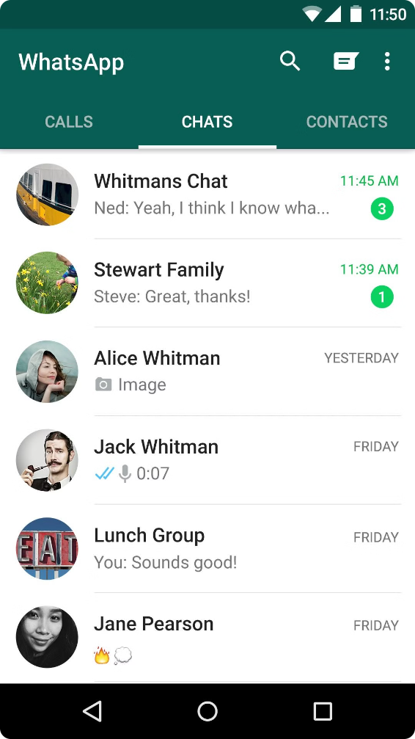
Stay Informed: Timely Updates
1
Admission Date Notifications
Once the admission phase begins, we'll promptly notify you via WhatsApp or SMS about the important dates to keep in mind. You'll be informed about application deadlines, merit list announcements, and other crucial milestones.
2
Personalized Communication
Our system utilizes the powerful Pywhatkit library for WhatsApp messaging and integrates with SMS APIs for those who prefer traditional text messaging. This ensures consistent communication across various platforms.

Slide 5
Admin Interface: A Central Hub
Student Data Management
Targeted Communication
Our dedicated admin interface, built using React JS, provides a comprehensive overview of all student inquiries. The administrator can easily access and manage the data collected from the inquiry form.
The admin interface empowers the administrator to send personalized messages to individual students or select a group of students for targeted communication. This feature ensures that the right message reaches the right individuals at the right time.

Slide 6





Merit List Announcements
Shortlisted Candidates
When the merit list is released, shortlisted students will receive a notification via WhatsApp or SMS congratulating them and inviting them to visit the college for admission confirmation.
Waitlist Information
Students not selected in the first merit list will be notified about the waitlist and encouraged to stay informed for subsequent merit lists. The system ensures timely and transparent communication regarding their status.
Admission Seats Full
In the unfortunate scenario where all admission seats are filled, students who have not been selected in any merit list will receive a message informing them about the situation. The system provides clear and concise communication about the final outcome.

Slide 7


Efficient and Effective
Feature
Benefit
Automated Communication
Eliminates manual messaging efforts, saving time and resources.
Personalized Notifications
Provides tailored information to each student, ensuring they receive relevant updates.
Centralized Data Management
Simplifies data storage and retrieval, allowing administrators to easily track and manage student inquiries.

Slide 8






A Seamless Admission Experience
Enhanced Transparency
Students and their families can stay updated throughout the admission process, reducing uncertainty and fostering trust in the institution.
Timely Notifications
Important deadlines and milestones are communicated promptly, ensuring that students don't miss out on key opportunities.
Responsive Communication
Students can reach out to the admissions office through various channels, receiving timely and personalized responses.
Improved Efficiency
The automated system streamlines the admission process, freeing up valuable time for admissions staff to focus on other important tasks.

Slide 9

Thank You for Listening
As we conclude our presentation, we hope you've gained a comprehensive understanding of our seamless admission experience. We're committed to guiding you through each step with transparency and responsiveness.

